Slide 1
CAPSTONE PROJECT
PROJECT TITLE
Presented By:
1.R. Pooja-Alagappa college of technology, anna university-chemical engineering

Slide 2
OUTLINE
Problem Statement
Proposed System/Solution
System Development Approach
Algorithm & Deployment
Result
Conclusion
Future Scope
References

Slide 3
PROBLEM STATEMENT
Python program for railway ticket booking.
The Indian Railways (IR) carries about 5.5 lakhs passengers in reserved accommodation every day. The Computerized Passenger Reservation System (PRS) facilitates the booking and cancellation of tickets from any of the 4000 terminals (i.e. PRS booking window all over the countries). These tickets can be booked or cancelled for journeys commencing in any part of India and ending in any other part, with travel time as long as 72 hours and distance up to several thousand kilometers.

Slide 4
PROPOSED SOLUTION
Users have a unique serial number (SN) used as primary key, name, email, phone, and adminship(decides if the user is an admin or not).
Each station has a unique serial number(PK) and station name.
All routes across the country are present here, each is identified by a serial number and the station which it passes through. One route contains more than one station.
Train entries have a unique train number(PK), name, source, destination, route, number of seats available, start time and end time. One train runs only on one route and has a single sou+rce and destination stations.
Booking details of each ticket contain a unique serial number, user who booked the ticket, train for which the ticket is booked, user’s departure and arrival station. One user may have more than one tickets also many tickets can be booked for the same train. Each ticket can have only one departure and one arrival stations.

Slide 5
SYSTEM APPROACH
User Input: Prompt the user to input details such as departure date, destination, number of passengers, etc.
2. Check Seat Availability: Query a database or use an algorithm to check seat availability for the given date and destination.
3. Reservation Confirmation: If seats are available, confirm the reservation and display the available seats to the user. If not, inform the user that seats are not available for the specified criteria.
4. Payment Handling: Implement a payment system to collect payment from the user for the reserved seats. This could involve integrating a payment gateway or using a mock payment system for demonstration purposes.
5. Ticket Generation: Generate and display tickets for the confirmed reservation, including details such as passenger names, seat numbers, departure date, destination, etc.
6. Cancellation Handling: Optionally, provide functionality for users to cancel their reservations and refund their payments.
7. Error Handling: Implement error handling to handle scenarios such as invalid user input, failed payments, etc., gracefully.
8. User Interface (Optional): Develop a user-friendly interface using libraries like Tkinter, Flask, or Django for a command-line or web-based application.

Slide 6
ALGORITHM & DEPLOYMENT
Algorithm
1.Initialize Database: Set up a database to store train schedules, seat availability, and reservations.
2.User Input: Prompt the user to input details such as departure date, destination, number of passengers, etc.
3.Check Seat Availability: Query the database to check seat availability for the specified date and destination.
4.Reservation Confirmation: If seats are available, confirm the reservation and update the database with the reservation details. If not, inform the user that seats are not available for the specified criteria.
5.Payment Handling: Collect payment from the user for the reserved seats. This could involve integrating a payment gateway or using a mock payment system for demonstration purposes.
6.Ticket Generation: Generate and display tickets for the confirmed reservation, including details such as passenger names, seat numbers, departure date, destination, etc.
7.Cancellation Handling: Optionally, provide functionality for users to cancel their reservations and refund their payments.
8.Error Handling: Implement error handling to handle scenarios such as invalid user input, failed payments, etc., gracefully.

Slide 7
Deployment:
1.Server Deployment: Deploy the application on a server using platforms like AWS, Google Cloud, or Heroku. Ensure that the server environment supports Python and any required dependencies.
2.Database Setup: Set up the database on the server and ensure that it's accessible to the application. Use appropriate database management systems like MySQL, PostgreSQL, or SQLite.
3.Web Interface: If deploying a web-based application, use frameworks like Flask or Django to build the frontend and backend components. Ensure that the server has the necessary web server software (e.g., Nginx, Apache) installed and configured.
4.Security: Implement security measures such as HTTPS, user authentication, and input validation to protect against common web vulnerabilities like SQL injection and cross-site scripting (XSS).
5.Scalability: Design the application to handle a large number of concurrent users and scale resources (e.g., server instances, database connections) as needed to meet demand.
6.Monitoring and Maintenance: Set up monitoring tools to track application performance, server health, and user activity. Perform regular maintenance tasks such as database backups, software updates, and security patches.

Slide 8
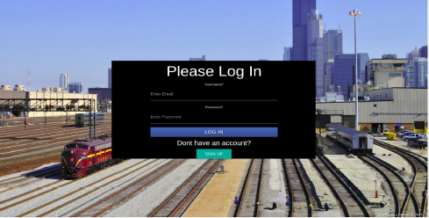
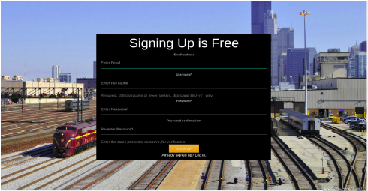
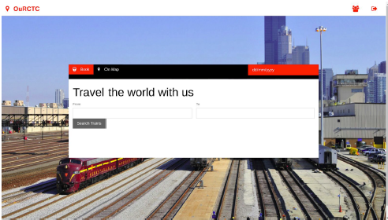
RESULT
1.Login form
2.Signup form
3.Home page

Slide 9
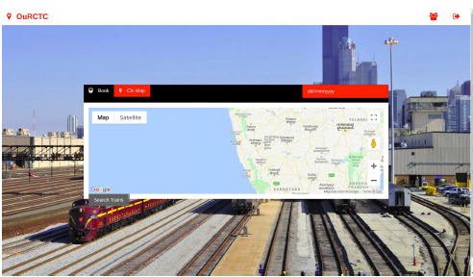
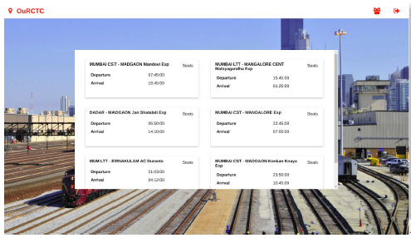
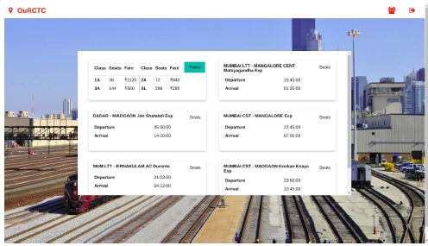
4.Select from map
5.Display trains
6.Display available seats

Slide 10
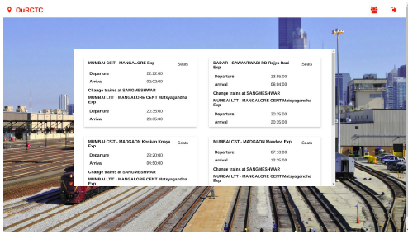
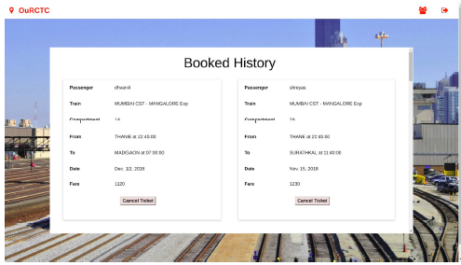
7.Display connecting trains
8.Booked ticket history

Slide 11
CONCLUSION
This Python program facilitates efficient train ticket booking, streamlining the process for users and enhancing their overall experience with its user-friendly interface and robust functionality.

Slide 12
FUTURE SCOPE
It includes potential enhancements such as
Integration with real-time train schedules
Advanced seat selection features.
Support for multiple payment gateways.
Incorporation of user feedback mechanisms for continuous improvement expansion to include additional transportation modes for a more comprehensive travel booking experience.

Slide 13
THANK YOU

